Slide 1
Team G: Jörmungandr
ECE: Greg Maclean, Warren Pryde
MechE: Jon Daneman, Anton Galkin

Slide 2
Jörmungandr (Team G)
Greg Maclean
Warren Pryde
Jon Daneman
Anton Galkin
24778 Mechatronic Design Project: Connect 4 Player

Slide 3
System Overview

Slide 4
Design Concepts
Stability and simplicity
Very clearly defined actuator positions
Minimal fine calibration needed to function
Lightweight (aluminum and acrylic)
Robustness
Aesthetics
Laser-cut acrylic provides a very polished look
Color scheme

Slide 5
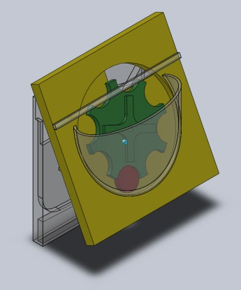
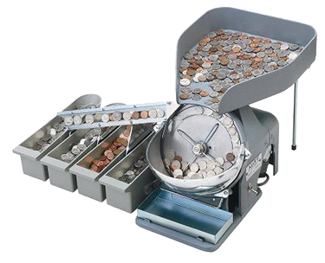
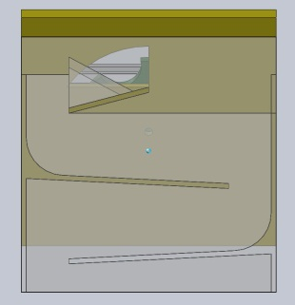
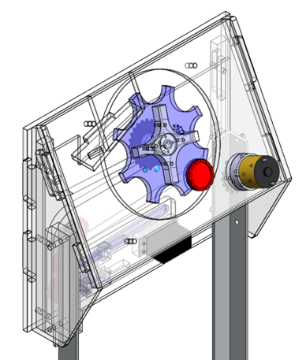
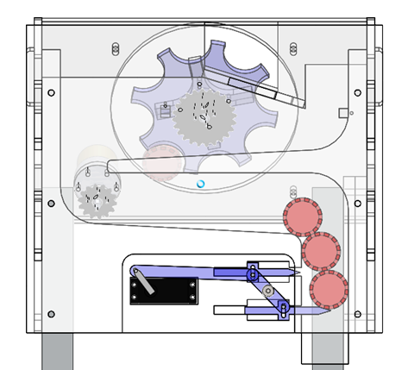
Chip Feeder
Inspiration
Pinwheel carries only oriented chips out of hopper
Ramp system holds on-deck chips: maximum speed

Slide 6
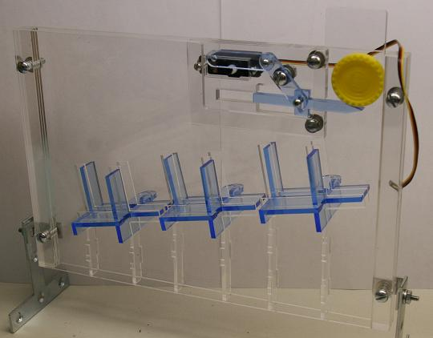
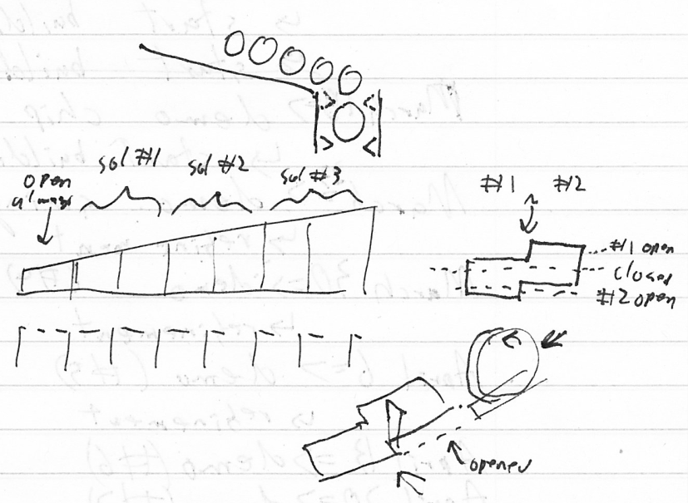
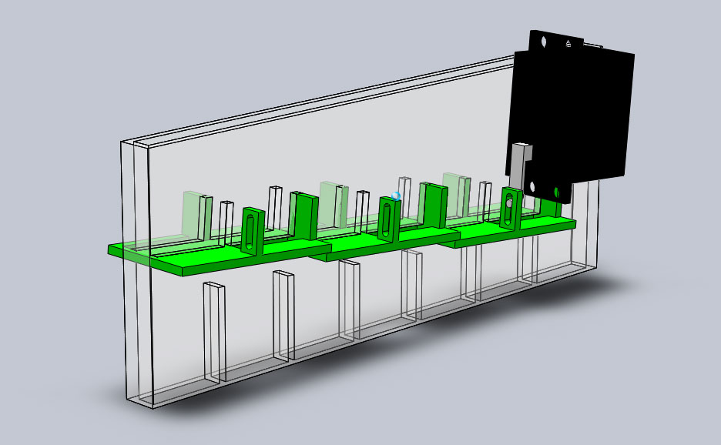
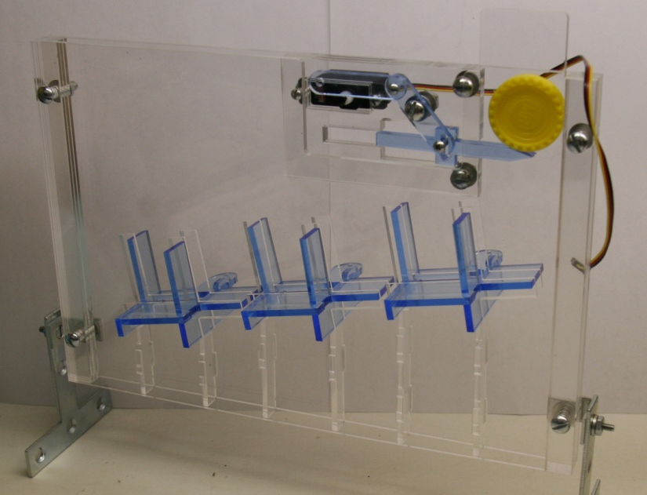
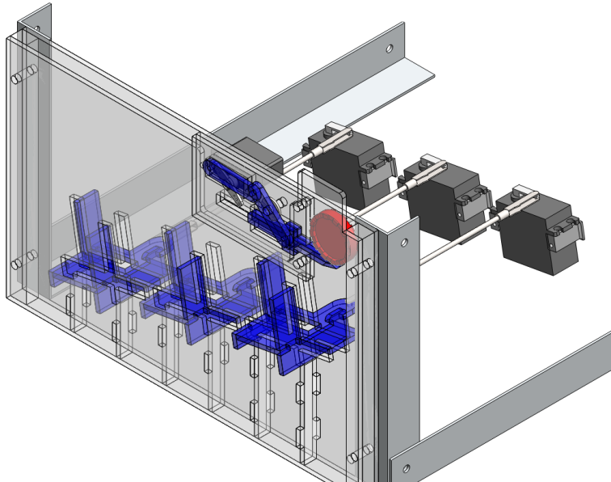
Chip Dropper
Concept CAD
Idea
Design-for-Manufacture CAD
Assembled Mechanism

Slide 7
Chip Dropper

Slide 8
Control Processor
Game Processor
(Arduino Uno)
TA Laptop
Neutral Zone
Control
Motion Processor
(Ardiuno Pro)
Chip Feeder
Chip Dropper

Slide 9
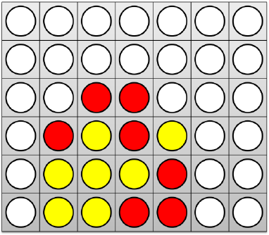
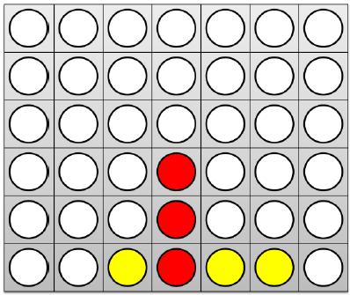
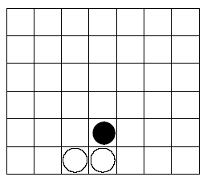
Game Processor Design
User Interface
Behind the Scenes: Game Board Evaluation
Difficulty Level
Block/Win Detection
Choose Move Strategy
3/group
Random Column Selection
EASY
“Is there currently a threat on the board?”
Images from Blackboard
3/group
Basic Strategy,
MEDIUM
“Is there currently a threat on the board?”
Initial Move Sequences
2 in a row
Basic Strategy,
HARD
“Will this move create a threat for either player?”
Initial Move Sequences
Image from Victor Allis’s Thesis
CHAMPION
Evaluate >4 moves into future
Game scenario recognition
…and more!

Slide 10
Coolness Factors
Human input pad
Allows human to decide move, and machine to execute move
Maintaining detailed game statistics
Logging all moves and game results on microSD card
LEDs to indicate state/position variables
Column selection, player number, etc.

Slide 11
Future Work
Remake chip dropper front and rear plates
Fabricate chip feeder and iterate
Integrate game and motion processors
Assemble frame for entire system
Optimize timing
Advance game processing
Coolness factors

