Slide 1
Design, Fabrication, and Testing of Lander Ramps For Rover Egress
11/21/2011
Zack Morrison
Hahna Alexander
Anton Galkin
Notes:
Anton

Slide 2
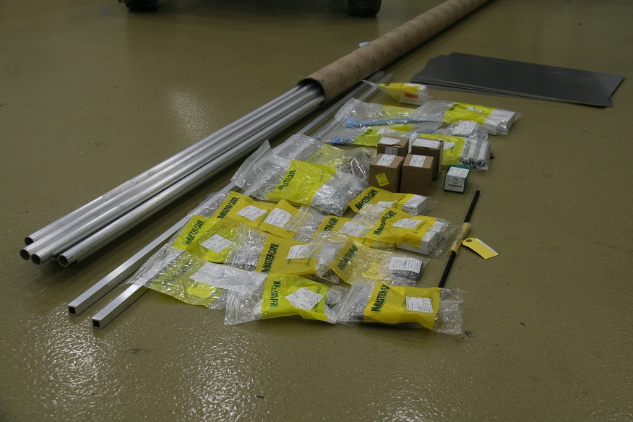
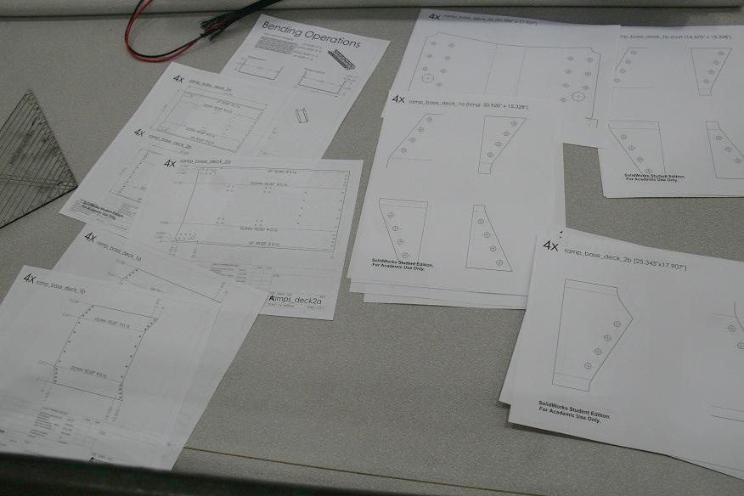
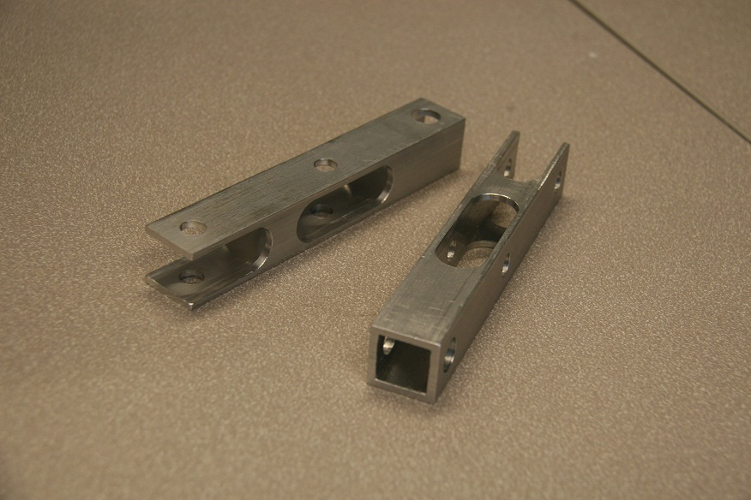
Fabrication is Underway
Parts arrived & inventoried
Machining started
Waterjet cutting underway

Slide 3
Outline
Problem statement
Motivation
Results
Contribution
Future work

Slide 4
Problem Identification and Motivation
Rover egress: the method by which the rover descends from the top of the Lander to ground.
Mission success depends on successful egress.
Implement mechanism to enable rover egress
Problem considerations:
Primary: rover safety, deployment reliability
Secondary: mass, cost

Slide 5
Approach
Researched design parameters and constraints
Compared designs in Pugh Chart
Selected 2 segment design
Extensive CAD modeling
Analysis: ANSYS, SolidWorks, Matlab
Created manufacturing drawings
Developed bill of materials, ordered parts
Fabrication

Slide 6
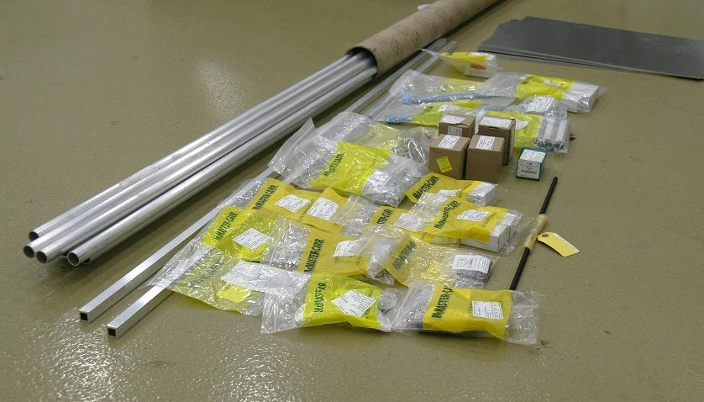
Parts Arrived & Inventoried

Slide 7
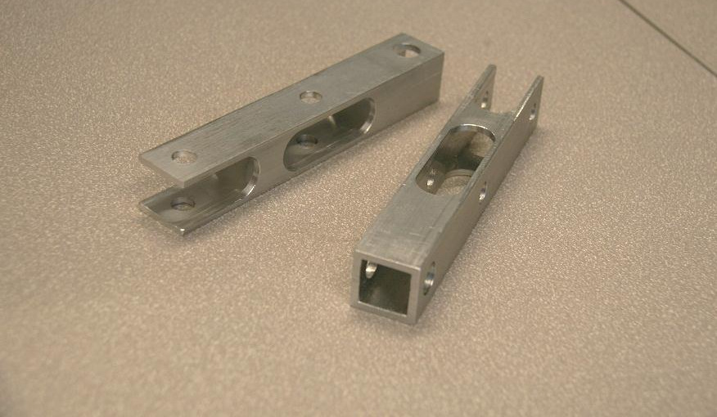
Machining Started

Slide 8
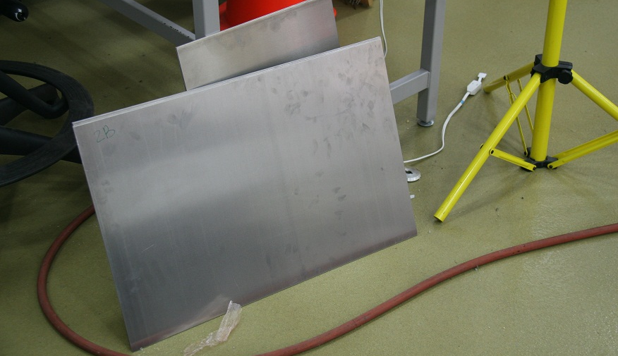
Metal & Drawings Sent to NREC

Slide 9
Ramp Deployment Torque
Springs provide proper deployment torque
SolidWorks Motion Analysis & hand calculations

Slide 10
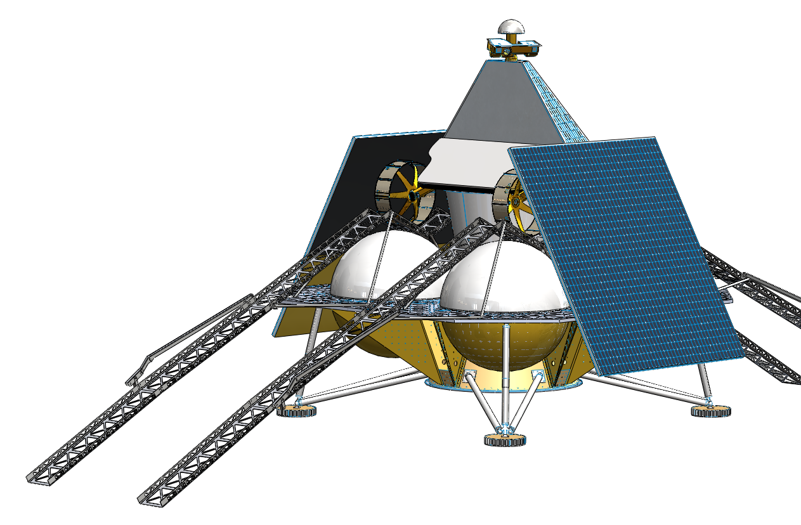
Contribution
Extendibility of ramp design for future iterations
Deployment kinematics
Feasibility of ramp design
Visual impact

Slide 11
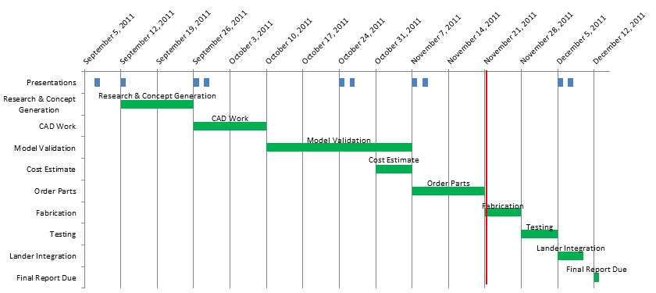
Semester Schedule

Slide 12
Future Work
ANSYS analysis of composite feasibility
ANSYS vibration testing
Implementation of extensive test plan
Small model rover egress
Geometry
Deployment reliability
Optimization of joint and body parameters
Weight
Stiffness
Class requirements: paper, final presentation, 1 blog

Slide 13
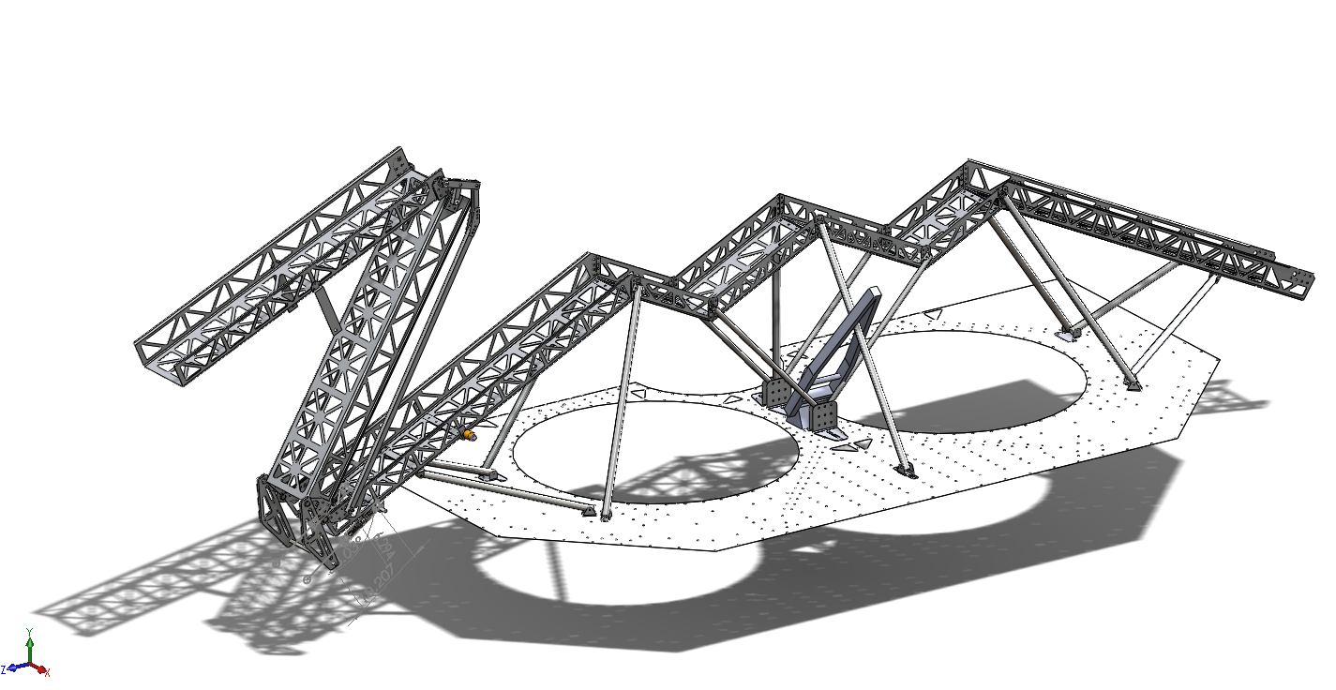
Questions?

Slide 14
Metrics
Analysis and selection of best design
Detailed CAD drawings and manufacturing plan
Ramp fabrication
Ramp deployment test
Rover egress test using a mockup rover
Simulations for future implementation

