Slide 1
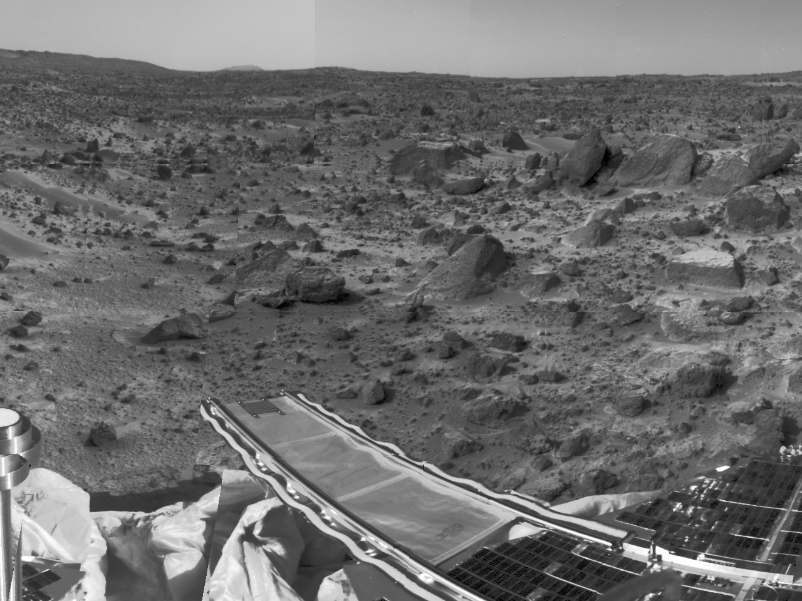
Rover Egress Design
Hahna Alexander
Anton Galkin
Zack Morrison
16-861 Mobile Robot Design – Fall 2011

Slide 2
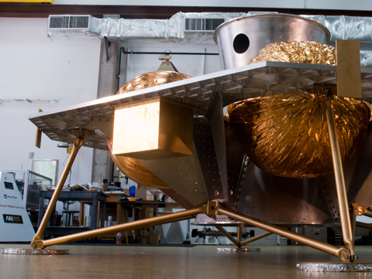
Issue and Motivation
Must create mechanism to allow for Rover to safely egress from the lander to lunar surface
Several possible solutions: (Ramp, Elevator, Net)
Try to keep as simple and reliable as possible

Slide 3
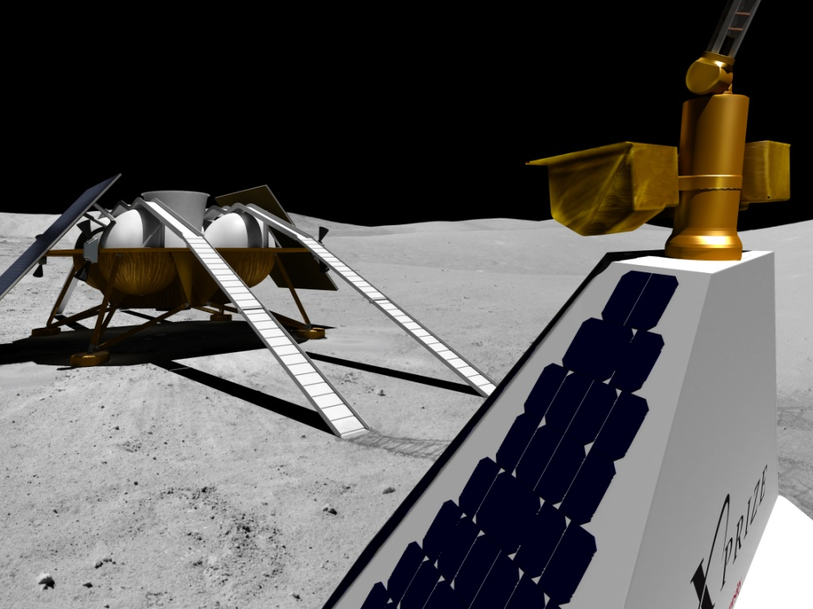
Technical Objectives
Linkage Mechanism Comparison
Fully explore hinged design
Charlie focused on telescoping
Deployment Demonstration
Drive Rover off of Lander
Design considerations
Stress from 110kg Rover
Vibration and acceleration of launch
Cost, Weight, Assembly

Slide 4
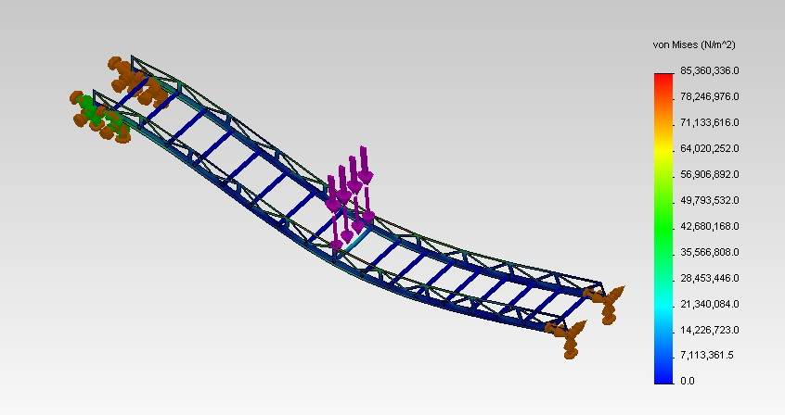
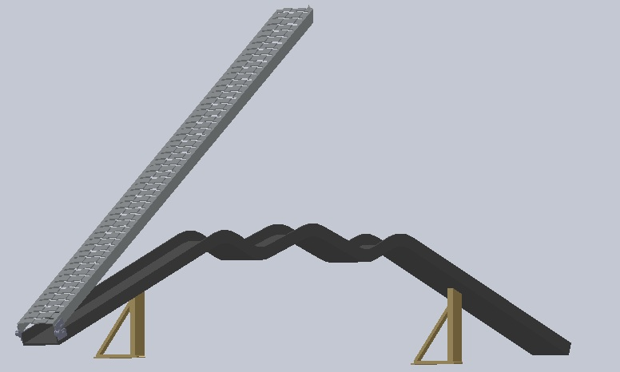
Mid-Semester Results
Research, Understand:
Design constraints of space
Existing solutions
CAD model
Stress and vibration analysis
Manufacturing plan
Bill of materials

Slide 5
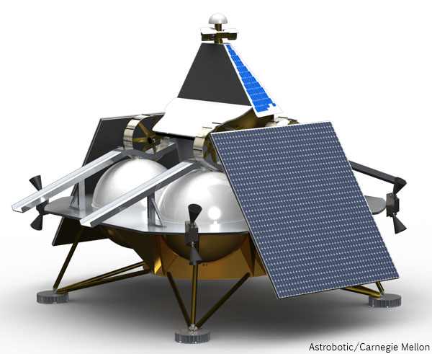
End of Semester Results
Working, full-scale prototype mounted to Lander mock-up
Physical tests of deployment mechanism verify compliance with engineering requirements
Demonstrate full-scale ramp deployment

Slide 6
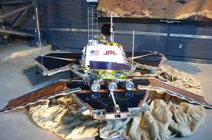
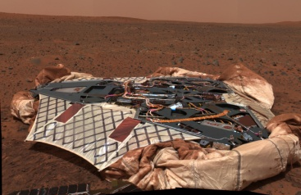
Prior Work
[1] “Tank On the Moon” http://www.youtube.com/watch?v=rMus9Fm7L6A
[2] “Mars Pathfinder Egress Deployable Ramp Assembly” Spence, Brian R.; Sword, Lee F. http://trs-new.jpl.nasa.gov/dspace/bitstream/2014/23848/1/96-0167.pdf
[3] “Lander - Mars Exploration Rover Mission” http://marsrover.nasa.gov/mission/spacecraft_edl_lander.html
[4] TiNi Aerospace, Inc http://www.tiniaerospace.com/fbt/frangibolt.html

Slide 7
Prior Work

